Slide 1

February 2023
Car Insurance Claims
Numann Malik

Slide 2

February 2023
Project Description
We analyzed behavioral data for the customers of a car insurance company. The goal was to identify key factors that are more likely to lead a customer to filing an insurance claim (e.g. for an accident). Our stakeholder would want to determine in particular, which customers are more accident prone and hence likely to file a claim, and hence either raise their premiums or consider denying them coverage (so as to maximize their profits or minimize their losses).

Slide 3
February 2023
Car Insurance Dataset
The dataset was sourced from the Kaggle – Car Insurance Dataset from the user ‘Sagnik Roy’.
This dataset utilizes 18 features for predicting auto insurance claims. The ‘Outcome’ target feature below indicates whether a customer filed a claim (1) or not (0).
Feature Name | Description | Feature Name | Description | Feature Name | Description
Age | 16-25, 26-39, 40-64, or 65+ | Credit Score | Between 0 and 1 (scaled) | Annual Mileage | Rounded to nearest 1000 miles
Gender | Male or Female | Vehicle Ownership | 0 (no) or 1 (yes) | Vehicle Type | Sedan or Sports Car
Race | Majority or Minority | Vehicle Year | Before 2015 or After 2015 | Speeding Violations | Numerical Frequency
Driving Experience | 0-9, 10-19, 20-29, or 30+ years | Married | 0 (no) or 1 (yes) | DUIs | Numerical Frequency
Education | High School, University, or None | Children | 0 (no) or 1 (yes) | Past Accidents | Numerical Frequency
Income | Poverty, Working Class, Middle Class, or Upper Class | Postal Code | 10238, 21217, 32765, or 92101 | Outcome | 0 (no) or 1 (yes)

Slide 4

February 2023
Stakeholder
Our analysis will be utilized by a car insurance company in order to assist with deciding which potential customers to provide coverage to, and how much to charge for their premiums.
Covering the cost of road accidents can be very expensive. Therefore, it is very important to investigate the history of current/former customers to predict who who to grant coverage to.

Slide 5
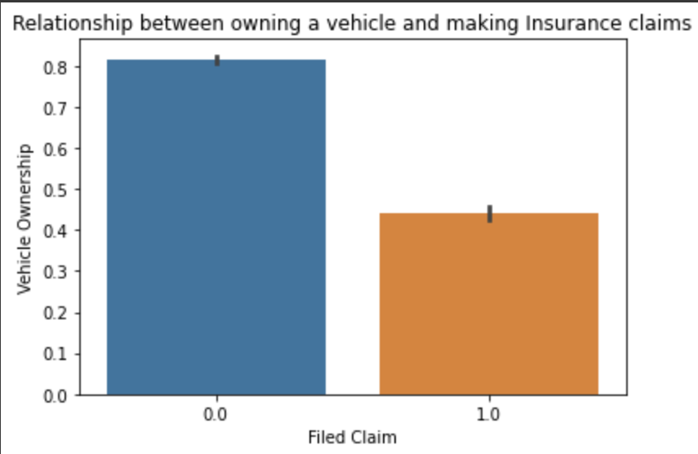
February 2023
Relevant Observation
Above we see that over 80% of customers who have never made an insurance claim owned their vehicle, while less than half have made a claim - supporting evidence that those who lease their vehicles are more likely to file claims with their insurance company.

Slide 6
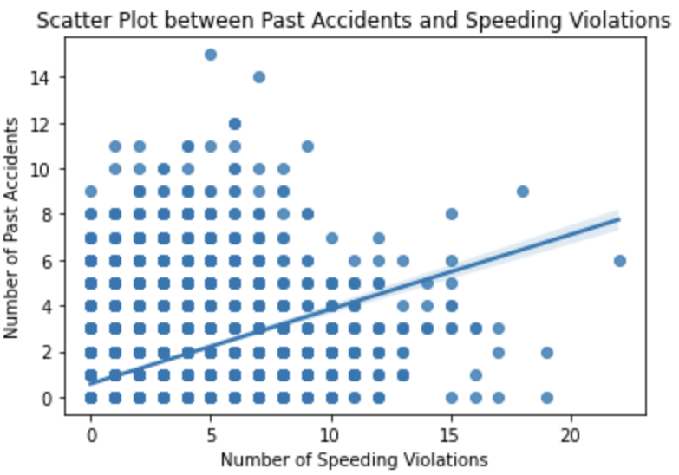
February 2023
Another Relevant Observation
From the above we can see there is a positive correlation between the number of past accidents and speeding violations. This would indicate that we should determine both for each potential customer before deciding to grant any coverage.

Slide 7
February 2023
Model Evaluation
Metrics to be added

Slide 8
February 2023
Model Evaluation
Classification report and Confusion Matrix for best model will be added.

Slide 9
February 2023
Recommendations
Recommendation 1 to be added.
Recommendation 2 to be added.
Recommendation 3 to be added.

